Slide 1

JEDI BOOTCAMP
Team - JEDI-05
Course Registration System

Slide 2
Framework for 3 weeks
Day 1 - UNIX
Day 2 - GIT
Day 3, 4, 5 - SDLC and OOAD
Day 11, 12 - MySql Fundamentals
Day 6, 7, 8, 9, 10 - Core Java
Day 13, 14 - Drop Wizard

Slide 3
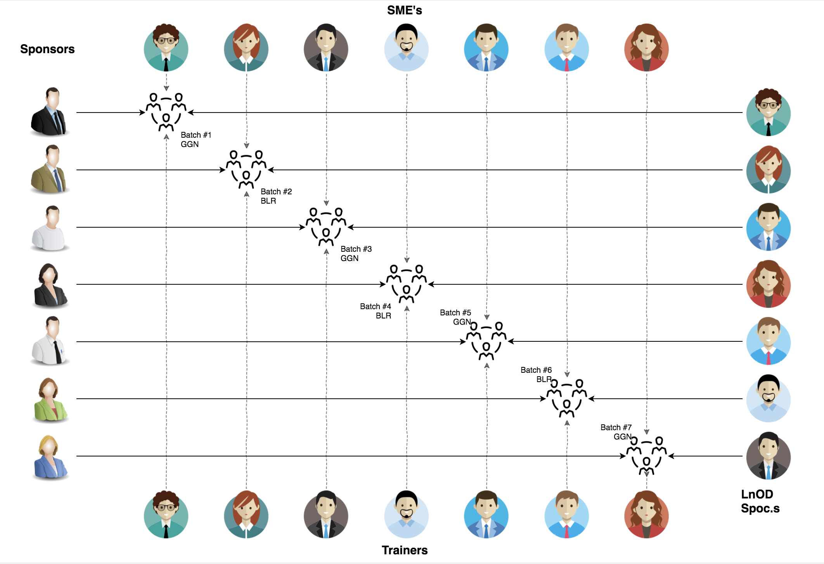
Stakeholders
Sponsors
1. Flipkart
SME’s
1. Zain
2. Other HR & Experts
Trainers
1. Amit Balyan

Slide 4
PLANNING
Notes:
Time – 1 min
Swati

Slide 5
3 WEEKS OF TRAINING + PROJECT DEMO
15 DAYS
150 HOUR
9000 MINUTES
5,40,000 SECONDS
LIMITLESS KNOWLEDGE

Slide 6

Agenda
01
Our Journey
02
Our Team
03
Project Goals
04
Engineering Practices
05
Tech Stack
06
Development
07
Challenges & Learnings
08
Demo
09
Questions
Notes:
Time – 1 min

Slide 7

Our Journey

Slide 8
Demo
Mindset
Process
5
Tools
4
Project Demo
Adapting to a Developer
mindset
Comprehend
3
Decide the Technologies JAVA/REST
2
Design Thinking (UML)
1
Understanding Project Goals

Slide 9

Our Team
Notes:
Time – 2 mins

Slide 10
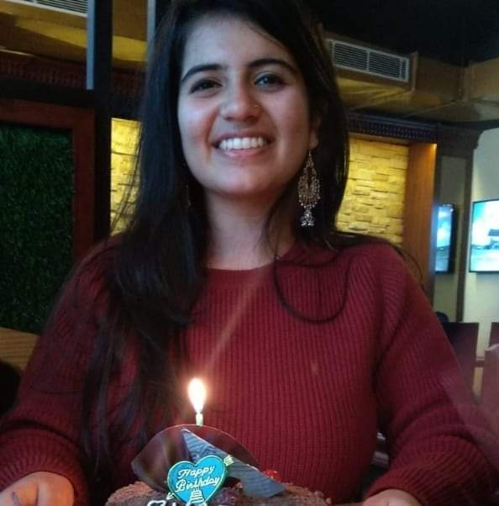
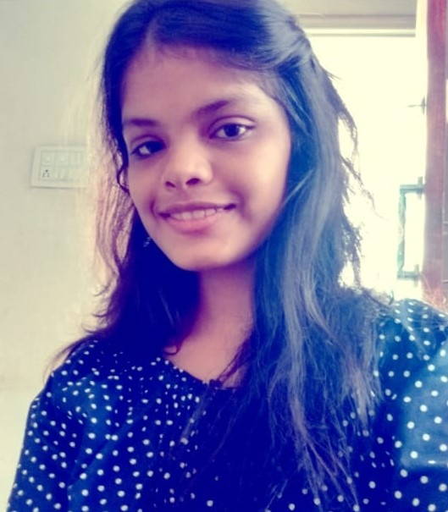
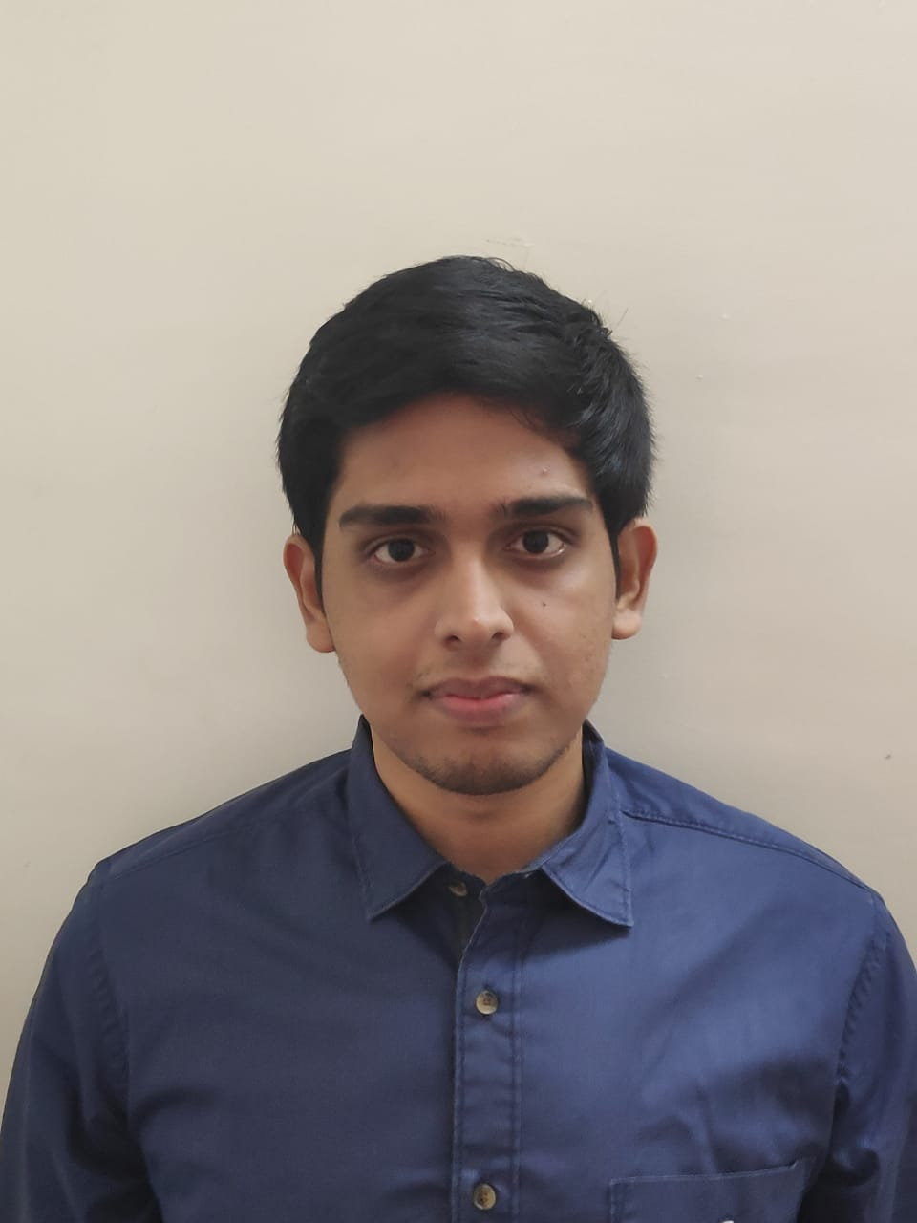
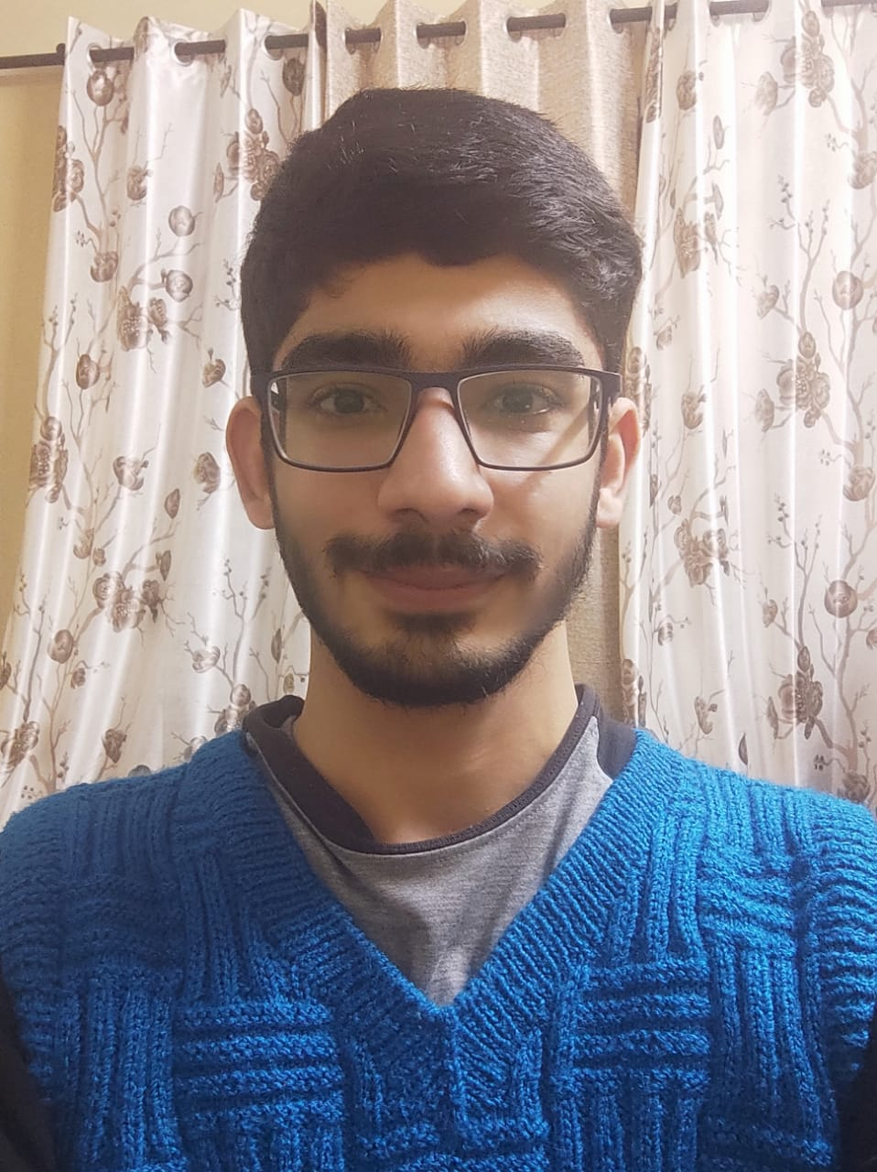
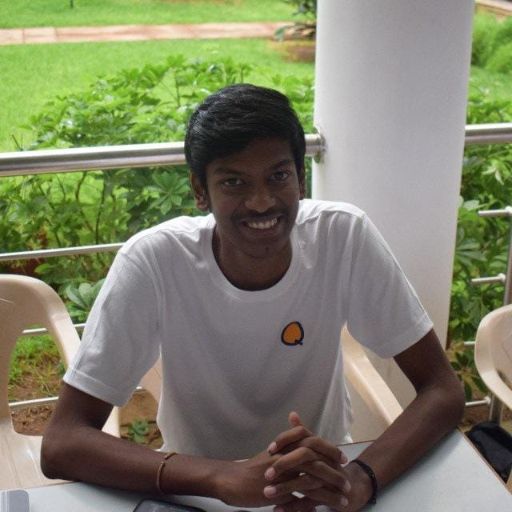
Sharvi Sethi
Kajal Parikh
Surya Vatsalya
Shivam Behl
Mathana Kumar

Slide 11




Our Vision
To create an Course Registration System using Java, MySQL, REST API and Drop Wizard where a student can register for courses from the catalog provided by receiving admin approval.
Student can also make payment for the courses per semester and view grades when uploaded by professor.
Admin can add professor, add course, delete course and validate student.
1
2
Quality
Security
3
4
Interactivity
Speed

Slide 12

Project Goals

Slide 13

Engineering Practices
Notes:
Time – 5 mins

Slide 14
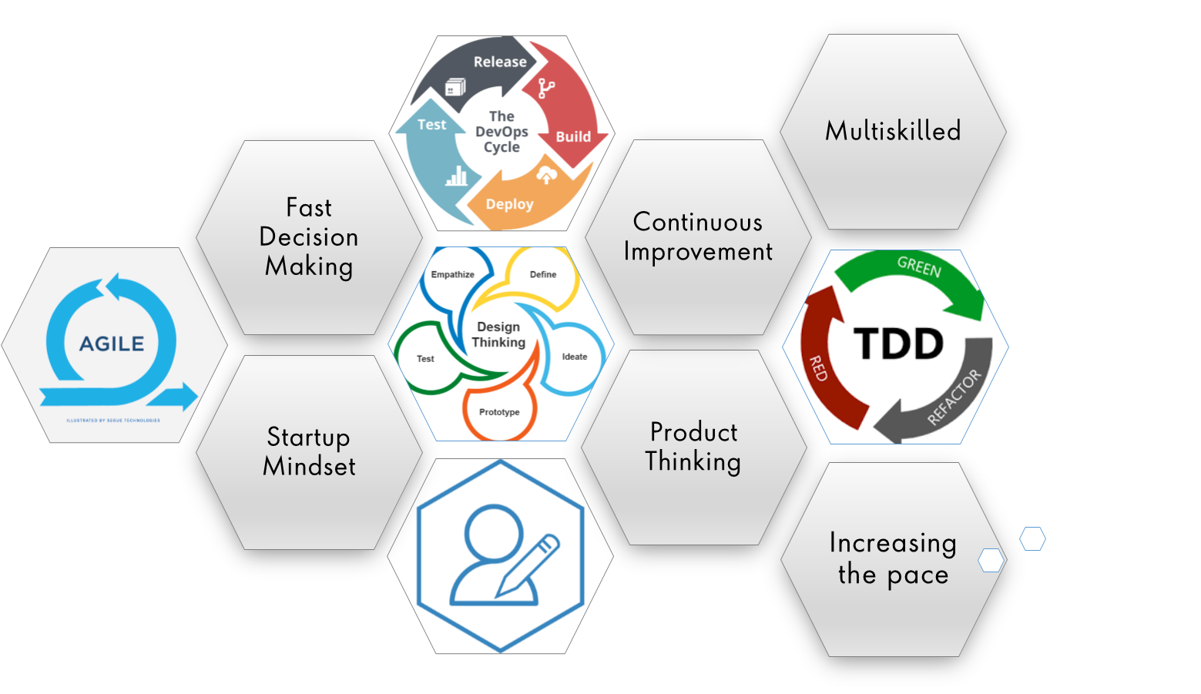
Image source: googleImages
Notes:
Product Thinking (Design Thinking, Requirement Analysis, )
Multi Skilled (Frontend, Backend, DevOps)
Fast Decision Making (Agile)
Increasing the Pace (Automation CI/CD)
Startup Mindset (Agile)
Continuous Improvement (Retros)

Slide 15
Define Objectives
Identify resources
Determine evaluation methods
Requirement understanding
Research and analysis
Estimation
Sprint Planning
Spring Grooming
Delivery
Sprint Implementation
LLD
Development
Code Review
Commit
Integrate
Deploy
Test
Notes:
Time – 1 min

Slide 16
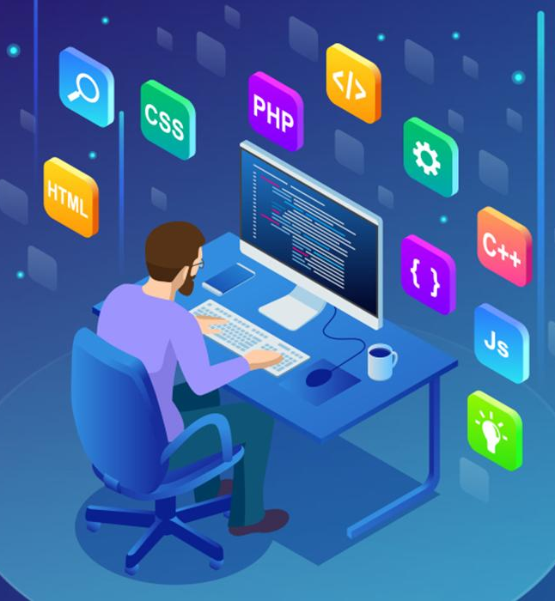
Tech Stack
Notes:
Time – 2 mins

Slide 17











Slide 18

Challenges & Learnings

Slide 19
Challenges
Resolving merge conflicts and version conflicts on Github.
Difficulties faced in Validation implementation.
Importing dependencies in Intellij framework.
IDE challenges.

Slide 20
Learnings
Got familiarized with Unix commands
Learnt version control using Git
Learnt UML Diagrams
Understood new Java 8 features
Understood RESTful development using Jersey
Development using DropWizard framework

Slide 21

Architecture
Http response
Http request
Business
Code
Database Code
MySQL Database
Browser
Java Client/UI

Slide 22

Demo

Slide 23

Questions

Slide 24
Thank you
Notes:
Time – After this show the testimonial video. 1 min

